Slide 1
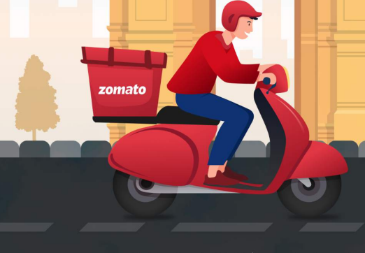
Zomato Restaurant Analysis
Presentation By:
Shashi kumar R

Slide 2
Introduction
This presentation will help us to take decisions for opening of new restaurants.
We will use the data of 15 countries for 9 years from 2010 to 2018.
My analysis shows several strategic requirements for the opening of new restaurants.
By analyzing the data of multiple locations, it is possible to identify countries with strong demand & minimum competition.
The parameters that we have used for analysis are no. of restaurants, expenditure, cuisines, ratings etc. to get insights.

Slide 3
Problem Statement
Suggesting some countries and cities for opening new restaurants and expansion strategies for Zomato by analyzing their datasets, the quality regarding ratings for restaurants that are already present in the countries, the cuisines that need to be focused, trends of the Online deliveries and table bookings, the rates of the cuisines.

Slide 4
Data Overview
Has_Table_booking: Indicates whether the restaurant has a table booking option (Yes/No).
Has_Online_delivery: Indicates whether the restaurant offers online delivery (Yes/No).
Is_delivering_now: Indicates whether the restaurant is currently delivering (Yes/No).
Switch_to_order_menu: Indicates whether users can switch to the order menu (Yes/No).
Price range: A numeric value indicating the price range category of the restaurant.
Votes: The number of votes or ratings/(feedback) received by the restaurant.
Average_Cost_for_two: The average cost for two people dining at the restaurant.
Rating: The overall rating of the restaurant is based on user reviews.
Datekey_opening: The date when the restaurant was opened.
Restaurant ID: A unique number that each institution is given.
Restaurant Name: The restaurant's name.
Country Code: The country code of the area in which the eatery is located.
City: The city in where the eatery is situated.
Address: The restaurant's precise address.
Locality: The area or community in which the eatery is located.
Locality Verbose: Comprehensive details on the area.
Longitude: The restaurant's geographic longitude coordinate.
Latitude: The restaurant's geographic latitude coordinate.
Cuisines: The variety of food that the restaurant serves.
Currency: The money that is exchanged in the restaurant.

Slide 5
Data Cleaning and Processing
Create a dynamic table that is linked to the raw data so that any modifications made by the business to the original data will be reflected in both the dynamic table and the dashboard.
Addressed the missing virtues in American food.
Determined the total number of eateries in each nation.
Translated several currencies into Indian rupees (INR) for comparison.
To retrieve the country code using the proper LOOKUP methods.

Slide 6
Methodology
Missing value treatment: Utilizing pivot tables, XLOOKUP functions, MAX functions, and the power query editor.
Data Enrichment: Using VLOOKUP, MID, SEARCH, TRUNC, CONCAT, and connecting tables to cross-reference with the original data source, the data set was enhanced with extra variables.
Descriptive Analysis: Used standard Excel functions (count, if, etc.) to analyze objective questions, conditional aggregational functions, and pivot tables to summarize important metrics.
Trend Analysis: Using sparklines, scatter plots, and trendlines, the trend between reviews and ratings, meal costs, online delivery, and reservations was examined.
Executive Segmentations: Various ratings, pricing, and other outcomes for different nations at different times were analyzed using year- and country-wise filters.
Data Visualization: To enable interactive data exploration, dynamic charts and a dashboard were created.

Slide 7
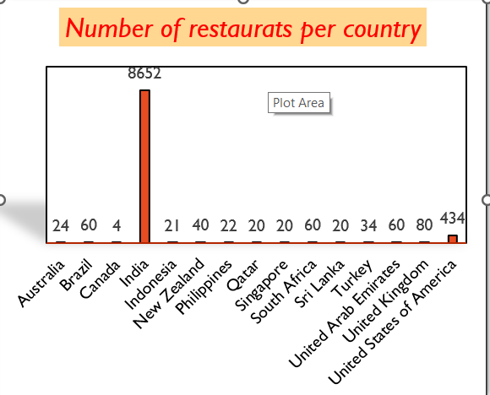
The number of restaurants opened in each country.
Chart displays the number of restaurants in each country of the dataset.
India is having the highest number of restaurants i.e. 8652
Second place is occupied by USA with 434 restaurants.
Canada is at the last of the graph indicating least number of restaurants i.e. 4

Slide 8
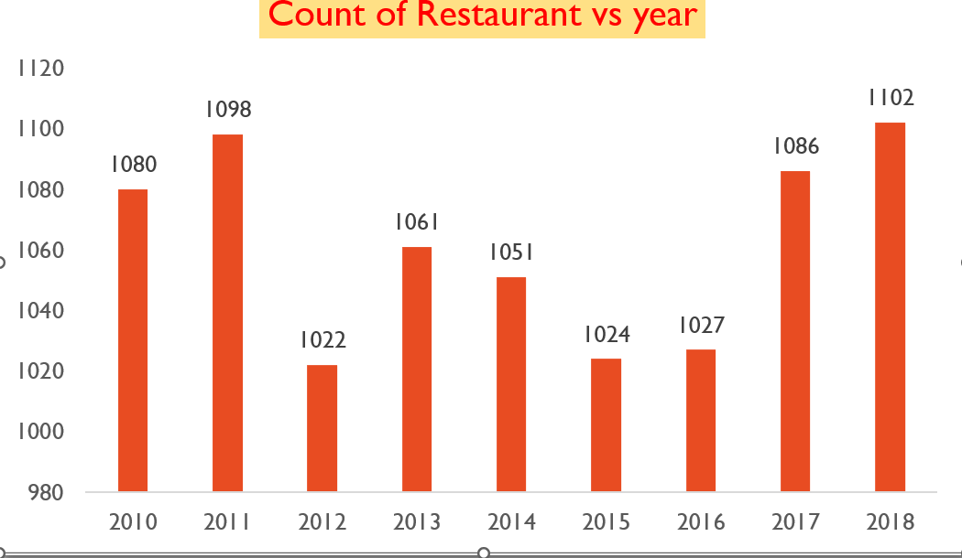
The number of restaurants opened each year.
Highest number of restaurant was open in year 2012, following with 2011, 2013.
After 2015 we can se a drop in 3yrs constantly

Slide 9
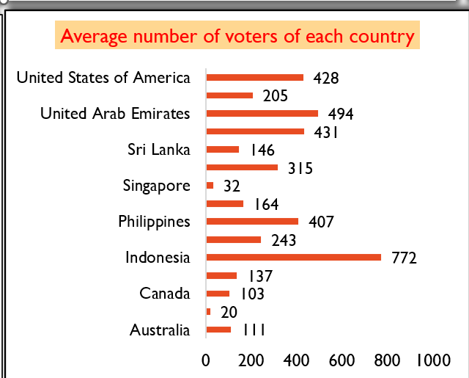
The average number of voters for the restaurants in each country.
Indonesia is having the highest number of voters in restaurants, followed by UAE, USA AND Philippines.
As compare to number of restaurants in India, the number of voters are very less.

Slide 10
Country Wise Expenditure Analysis.
Highest and Lowest Expenditures
Canada has the highest average food cost.
Turkey has the lowest average food cost.
General Cost Observation
Canada has notably high average food costs, suggesting that dining out in this country is relatively expensive.
Turkey has relatively lower average food costs, indicating more affordable dining options.

Slide 11
Country Analysis.
Most suitable countries (cities) for opening new restaurants
Based on criteria where total number of restaurants are less than 200, average ratings are higher than or equals to 3, with less than Rs 1600 average expenditure for two person to have a meal and number of voters higher than 150, are :
Australia (Beechworth, Hepburn Springs, Phillip Island),
Canada (Chatham-Kent), Indonesia (Bogor, Jakarta),
New Zealand (Auckland, Wellington City),
Philippines (Mandaluyong City, Pasig City, Quezon City, San Juan City), Qatar (Doha), South
Africa (Cape Town, Johannesburg, Pretoria, Randburg, Sandton),
Sri Lanka (Colombo), Turkey (Ankara, Istanbul), UAE (Abu Dhabi, Sharjah)

Slide 12
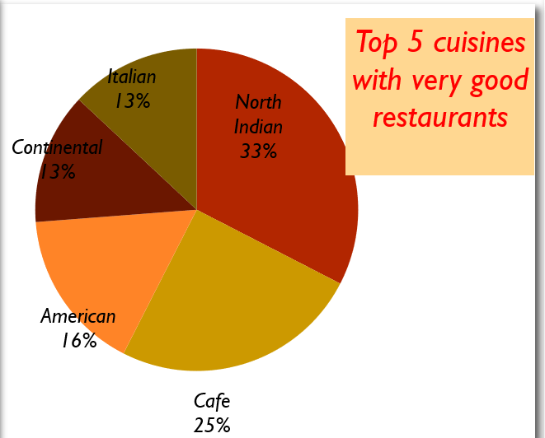
Top 5 Cuisines with votes.
Insights :- It is evident from the following data that North Indian, Muglai is the most popular and highly rated food among consumers. The top five cuisines, as determined by customer votes, are listed above, and their popularity can be inferred from the quantity of votes. More number of votes – More popular among consumers. Less number of votes – Less popular, need to work on the feedbacks by the consumer for the improvement of those cuisines.

Slide 13
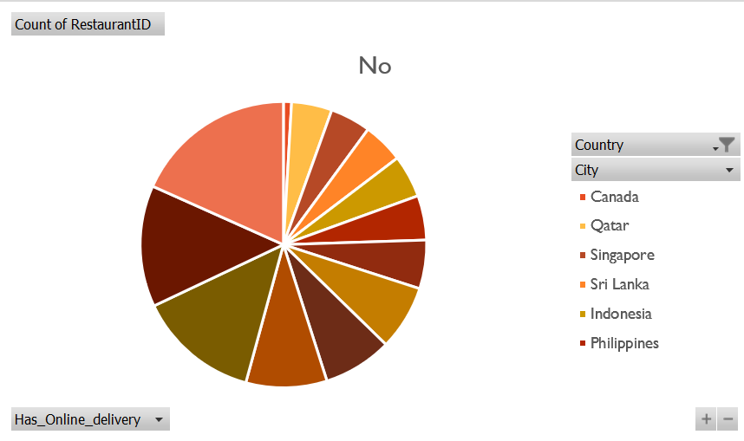
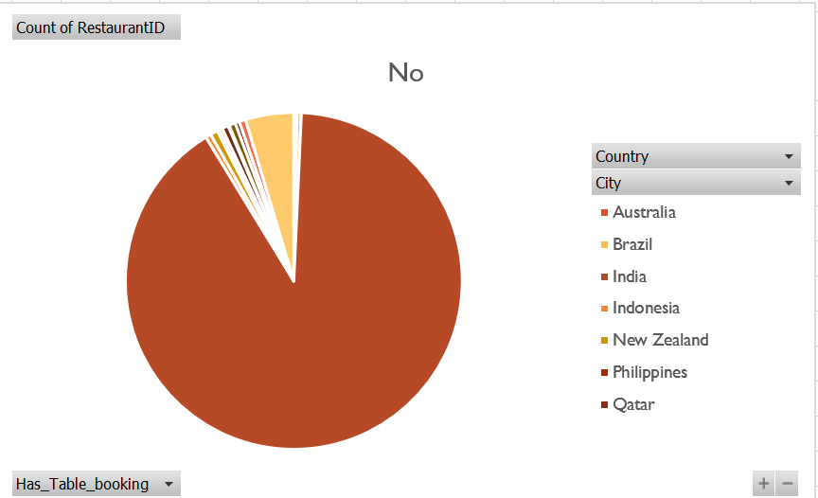
Online delivery and table booking affects the customer’s ratings:
Insights: -Ratings for restaurants that offer both online ordering and table reservations are rising. Thus, we may conclude that online ordering and delivery do have an impact on consumer evaluations.
Recommendations: For the convenience of the customer, incorporate online ordering and table reservations .

Slide 14
Should the team keep the rate of cuisines higher? Will that affect the feedback?
Insights: - We may conclude that there is a positive correlation between the rates of cuisines and ratings because the linear forecast trendline is moving slightly upward and the correlation coefficient is trending towards +1. This means that as one variable rises, the other one tends to rise as well.

Slide 15
The distribution of the number of restaurants of different price ranges in all the countries.
Visualization: - Doughnut chart since we need to show many parts (like price range) taking up space within a single unit (like country).

Slide 16
OBSERVATIONS AND ANALYSIS
General Distribution:
Price Range 1: This range has the highest number of restaurants (4444). It indicates a strong presence of budget-friendly or low-priced dining options across countries.
Price Range 2: This range has the second-highest number of restaurants (3113), suggesting a significant portion of mid-range dining options.
Price Range 3: There are (1408) restaurants in this range, showing a moderate presence of higher-priced dining options.
Price Range 4: The lowest number of restaurants (586) are in this range, indicating fewer high-end or premium dining options

Slide 17
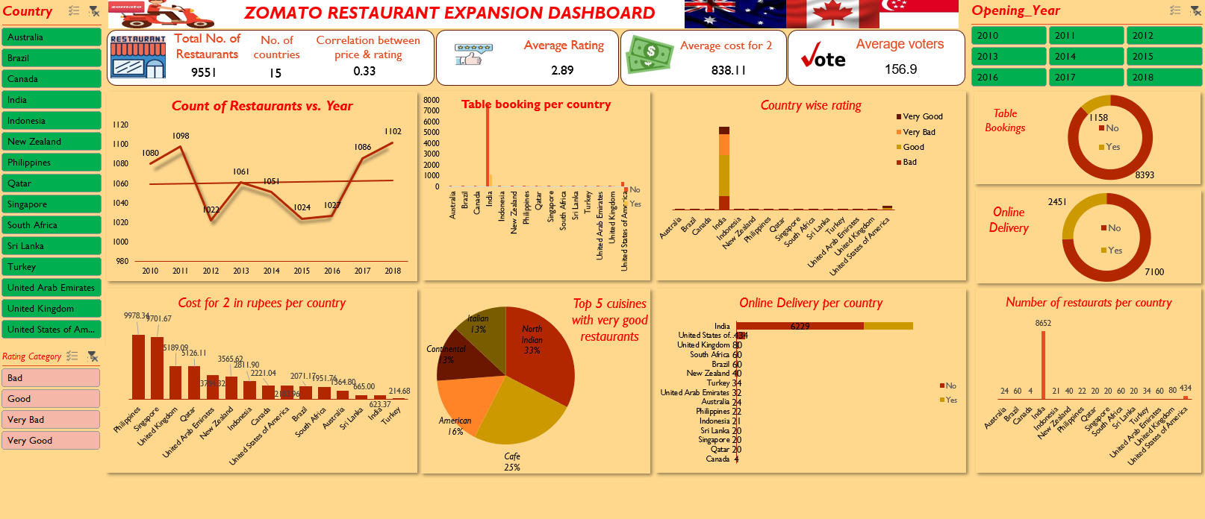
DASHBOARD

Slide 18
Conclusion
The analysis reveals valuable insights into restaurant data, guiding strategic decisions for expansion and improvement. Key findings include:
Identification of countries with low competition and high potential for new restaurant ventures.
Understanding customer preferences and the impact of factors like cuisine, price range, and services on ratings.
Recommendations for targeted culinary offerings, service enhancements, and pricing strategies to enhance customer satisfaction and competitiveness.
Visualizations provide clear insights into market trends, competitor analysis, and financial expenditure.
This analysis underscores the importance of data-driven decision-making in the restaurant industry, enabling businesses to optimize performance and meet evolving consumer demands effectively.

Slide 19
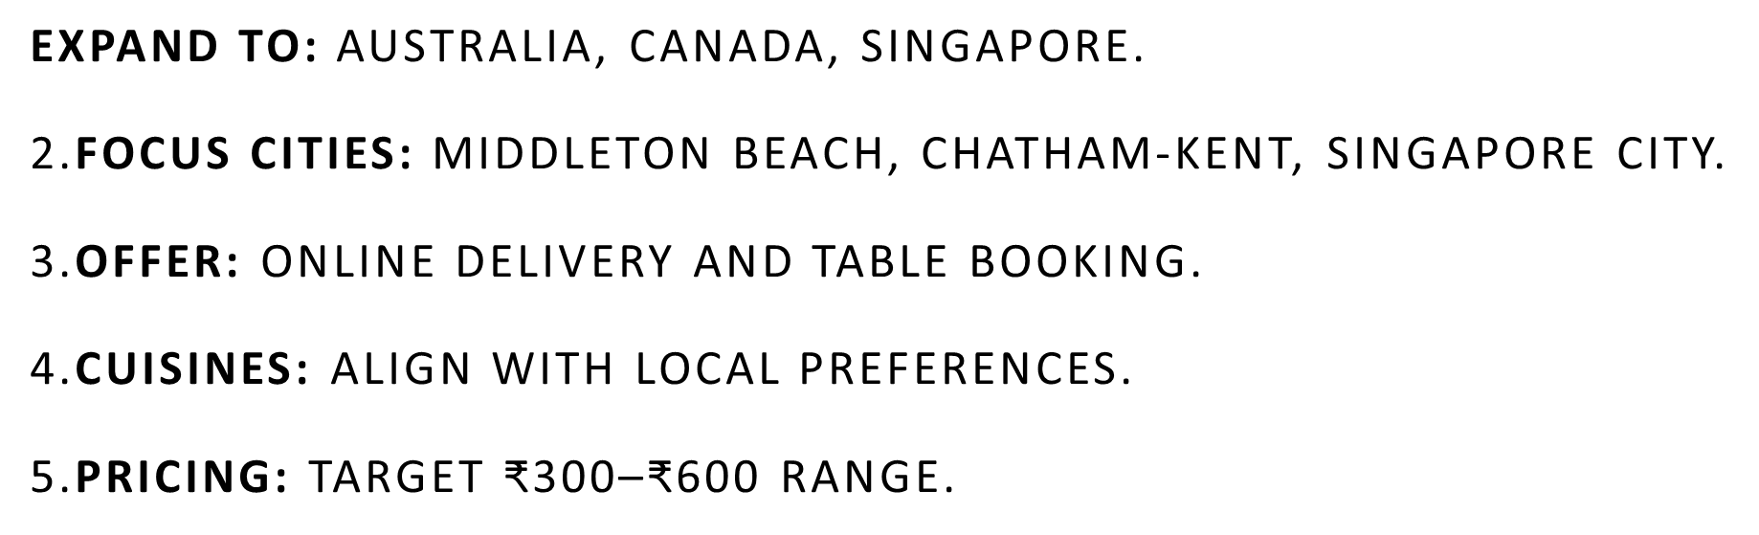
Final Recommendations

Slide 20


